Slide 1
EfficientDet (1)
EfficientDet: Scalable and Efficient Object Detection
2024-12-23
Sein Choi
Intelligent Vision Processing Lab. (IVPL)
https://ivpl.sookmyung.ac.kr
Div. of AI Engineering, Sookmyung Women’s University
E-mail: csi1806@sookmyung.ac.kr

Slide 2
Contents
Introduction
Related Work
BiFPN
Weighted Feature Fusion
Final BiFPN
EfficientDet Architecture
Compound Scaling
Result

Slide 3
Introduction
Increasingly Expensive Detectors
Due to resource constraints in real-world applications, deployment becomes challenging.
Efforts for Efficiency
one-stage
anchor-free detectors
compress existing models
But, Lacks in Accuracy
keypoint in Paper
scalable detection architecture + higher accuracy + higher efficiency + wide spectrum of resource constraints
2 Main Challenges
Efficient multi-scale feature fusion
Model Scaling
Output
= EfficientDet (a new family of object detection)
= EfficientNet backbone + BiFPN
Notes:
Keypoint : (논문에서 주로 고려한 것)
2 main Challenges
1. Efficient multi-scale feature fusion
FPN 도입 이후, multi-scale feature fusion에 많이 사용됨.
최근 PANet, NAS-FPN 등이 cross-scale feature fusion을 발전시킴
Feature Fusion이란?
대다수 연구들은 다른 입력 feature들을 받아도 단순히 sum 하기만 함 (without distinction)
문제점
다양한 input feature들은 다양한 resolution들을 가지고 있기 때문에 fused된 output feature에 불균형적으로 기여함.
문제 해결
BiFPN 제안 (Weighted Bi-directional Feature Pyramid Network)
서로 다른 input feature들의 중요성을 학습하기 위해 learnable weights를 도입함.
여러 번의 top-down, bottom-up multi-scale feature fusion을 적용함2
2. Model scaling
이전 연구들은 높은 정확도를 위해 큰 backbone network를 사용하거나 큰 input image size사용
우리의 관측 내용
정확도와 효율성을 모두 고려할 때 feature network와 box/class 예측 network를 모두 scale-up 하는 것 또한 중요함을 확인.
EfficientNet에 영향을 받아, 객체 탐지를 위한 복합(compound) scaling 방법을 제안함.
모든 backbone, feature network, box/class 예측 네트워크의 resolution/depth/width를 동시에 scale up 한다.

Slide 4
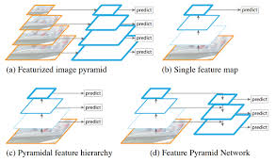
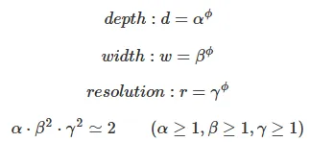
Related Work
One-Stage Detectors:
Region-of-Interest proposal step
X | O
One-stage detector | Two-stage detectors
Multi-Scale Feature Representations:
Key Issues in Object Detection : difficulty of efficiently representing and processing multi-scale features.
Early detectors relied on FPN, utilizing a top-down pathway to combine multi-scale features. (ex. PANet, STDL, M2det, G-FRNet, NAS-FPN)
In this paper, we aim to optimize multi-scale feature fusion in a more intuitive and principled manner.
Model Scaling:
Existing Methods: The backbone network is expanded, and the input image size is increased 512 to 1536. This scaling method focuses on a single or limited scaling dimension.(limitations)
We will propose our own compound scaling method for object detection, inspired by EfficientNet's compound scaling method.

Slide 5
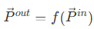
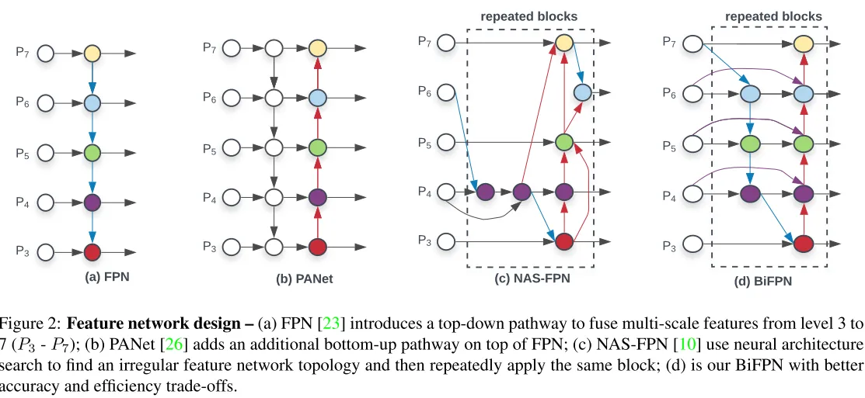
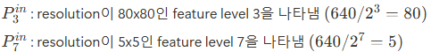
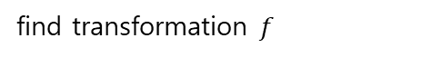
BiFPN
Goal : Combining features at different resolutions
Solution
formulate the multi-scale feature fusion problem
Introduce BiFPN : efficient bidirectional cross-scale connections and weighted feature fusion
find transformation$f$
A transformation f that can effectively aggregate different features and output a new list of features
Notes:
https://www.notion.so/seinchoi/EfficientDet-12-23-bb410b54033f4354a3e9664e773cf262?pvs=4#15e897346a4880779a6ec93f522f5005
노션 링크 참고.. 3.1 Problem Formulation

Slide 6
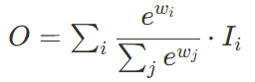
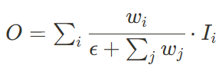
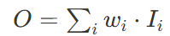
Weighted Feature Fusion
1. Legacy
3. Softmax-based Fusion
General Method: Adjust to the same resolution and then sum up.
Previous methods treated input features equally without distinction.
Problem: different input features, being at different resolutions, contribute unequally to the output feature.
Proposal: suggest adding additional weights for each input, allowing the network to learn the importance of each input feature.
All weights are normalized to be probabilities between 0 and 1, converting them into the importance of each input.
Problem: extra softmax can slow down GPU speeds.
Solution: To minimize latency costs, we will propose a fast fusion approach below.
2. Unbounded Fusion
4. Fast Normalized Fusion
Result : adjusted and combined according to their importance.
​: Learnable weight. It can be a scalar (per feature), a vector (per channel), or a multi-dimensional tensor (per pixel).
to avoid numerical instability.
Applying ReLU to ensure that ≥0,
The normalized weight values are between 0 and 1, and the absence of softmax makes the computation much more efficient.
Result: Similar learning and accuracy to softmax, with up to 30% faster execution on the GPU.
Problem : Scalar weights are unbounded, which can lead to instability in learning.
Solution: We limit the value range of each weight through weight normalization. (bound the value)
Notes:
3.3. Weighted Feature Fusion
기존의 feature fusion 방법
일반적 방법 : 동일한 resolution으로 조정한 후 sum up 한다.
Pyramid attention network의 방법 : pixel localization을 복원하기 위해 global self-attention upsampling을 도입하기도 함.
이전의 모든 방법들은 input feature들을 구분 없이 동등하게 취급함
문제점!!
서로 다른 input feature이 서로 다른 fesolution에 있기 때문에, output feature에 기여하는 정도가 unequally불균형 하다는 것을 관측함
제안
각 input에 대해 추가적인 weight를 추가하고, 네트워크가 각 input feature의 중요성을 학습하도록 제안.
Unbounded fusion: (제한 안 둔경우)
$O=\sum_i w_i\cdot I_i$
$O$ : output feature(출력 특성). input feature의 weighted sum으로, 각 입력 특성이 그 중요도에 따라 조정된 후 결합된 결과.
$w_i$ : 학습가능한 weight. (scalar (feature 당), 혹은 vector (채널 당), 혹은 multi-dimensional tensor (픽셀 당) 이 될 수 있음)
우리는 feature scale이 다른 접근 방식과 유사한 accurcy 달성하면서도 최소한 cost로 가능함을 발견
그러나 단점 : scalar weight는 제한이 없기 때문에(unbounded), 학습의 불안정 초래할 수 있음
해결
weight normalization(가중치 정규화)를 통해 각 weight의 값 범위를 제한한다. (bound the value)
Softmax-based fusion: (softmax 적용)
$O=\sum_i\cfrac{e^{w_i}}{\sum_j e^{w_j}}\cdot I_i$
직관적 아이디어 : 각 weight에 softmax를 적용한다.
((e를 넣은 이유 : 큰 값을 크게, 작은 값을 작게 하여 스케일 조정, 비선형성 부여, softmax는 주어진 입력 값들을 확률 분포로 변환하기 때문에 e를 사용하면 양수로 보장되어 전체 합 1이 되도록 정규화 가능. ))
softmax 식
모든 weight가 probability(확률)인 0~1 사이로 normalized됨. = 각 input의 중요성으로 변환됨
문제점
section 6.3. 참고, extra softmax는 GPU 속도 늦추는 문제점 있음.
지연 비용 최소화를 위해 아래에서 fast fusion approach를 제안할 것.
Fast normalized fusion:
$O=\sum_i\cfrac{w_i}{\epsilon +\sum_j w_j}\cdot I_i$
$w_j$에 Relu 적용시켜서 $w_i\geq 0$임을 보장한 후, numerical instability를 피하기 위해 $\epsilon$=0.0001을 사용함.
정규화된 weight 값이 0~1 사이에 있으며, softmax 없기 때문에 연산이 훨씬 효율적이다.
결과: softmax 와 유사한 학습과 정확도, GPU에서 최대 30% 빠르게 실행됨.

Slide 7
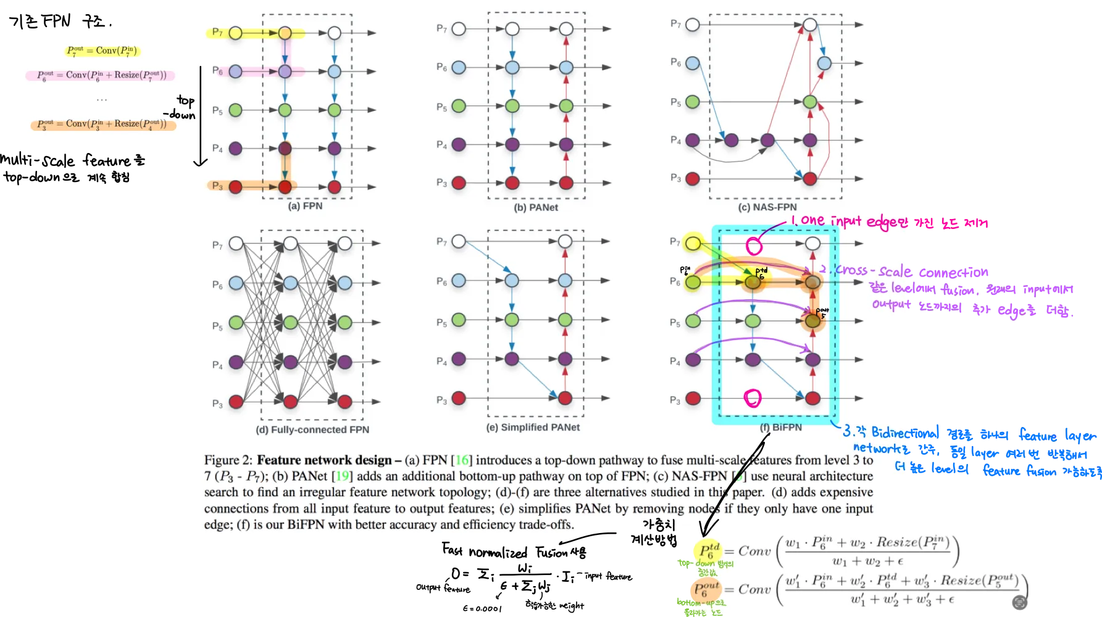
Final BiFPN
bidirectional cross-scale connections + fast normalized fusion
1. For more efficiency, using depthwise separable convolution.
2. conv->batch normalization->activation

Slide 8
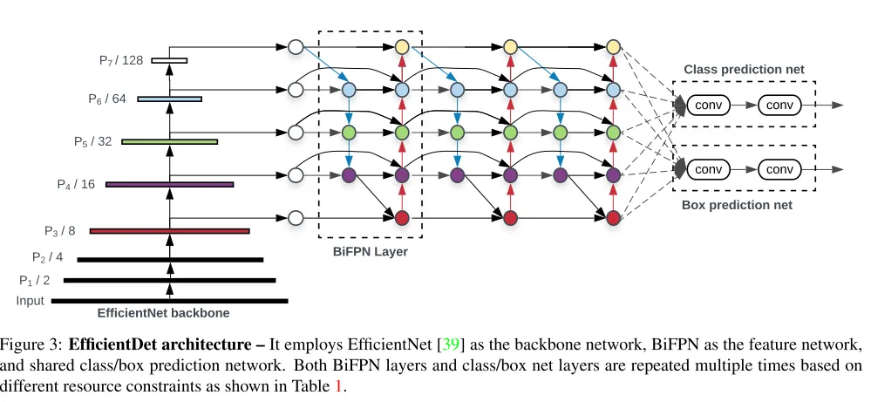
EfficientDet Architecture
one-stage detector 따름
backbone으로 ImageNet을 pretrain한 EfficientNet을 사용
bidirectional feature fusion 진행

Slide 9
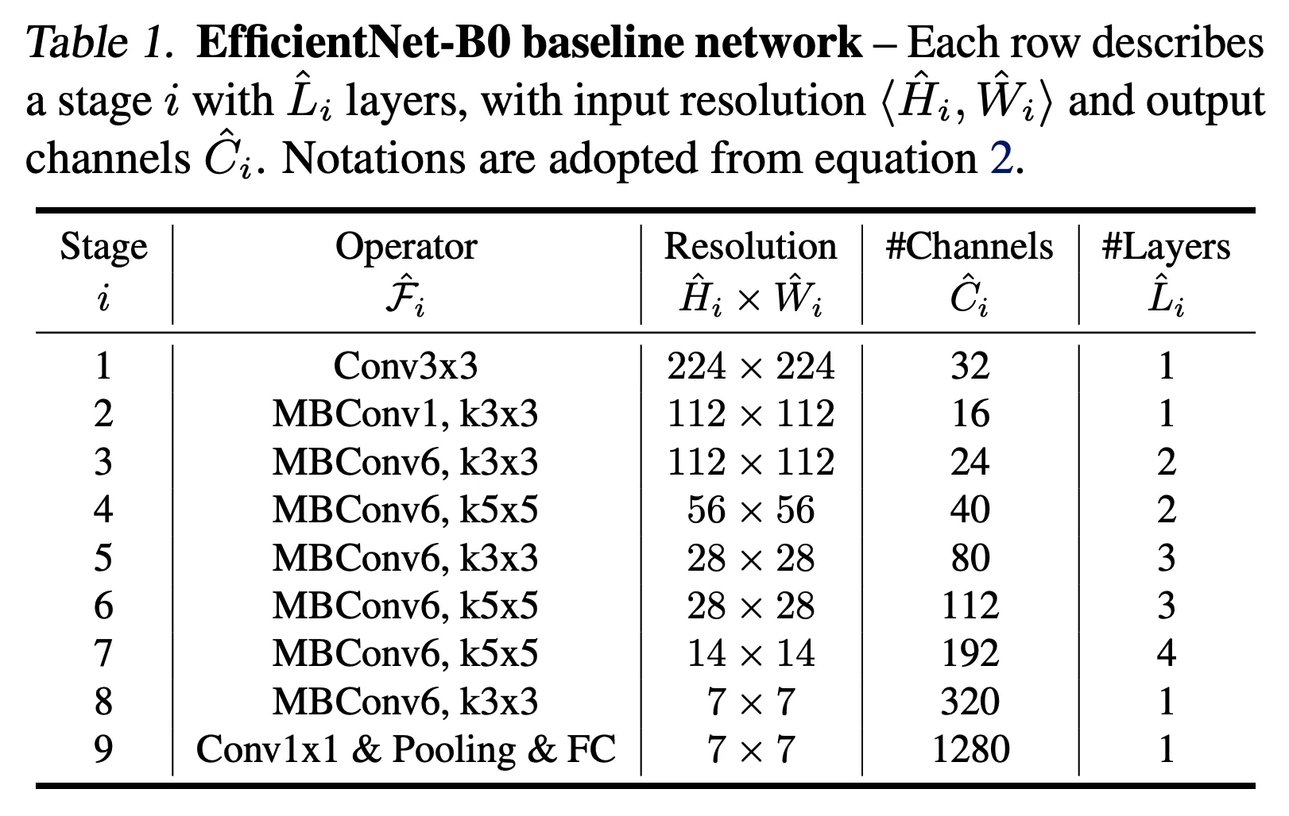
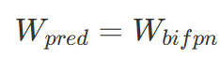
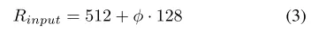
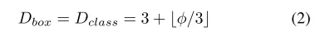
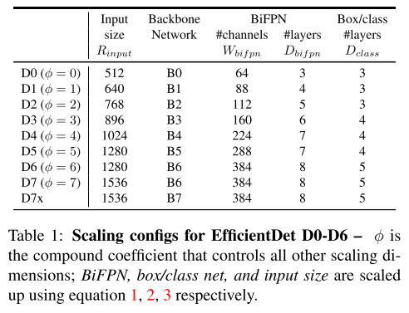
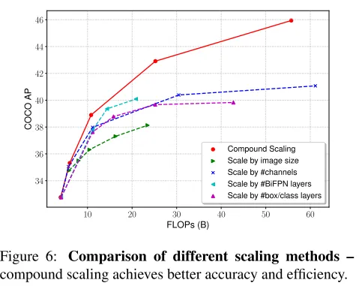
Compound Scaling
single or limited scaling dimension에 제약있는 scale up 방법 대신 ‘a new compound scaling method for objection’ 방법을 제안함.
grid search 대신 heuristic-based scaling approach 사용
Box/Class Prediction Network
Input Image Resolution
BiFPN Network

Slide 10
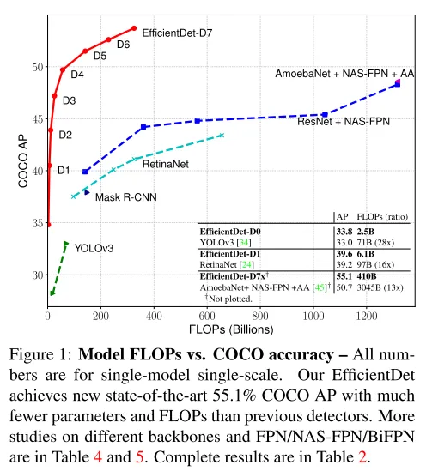
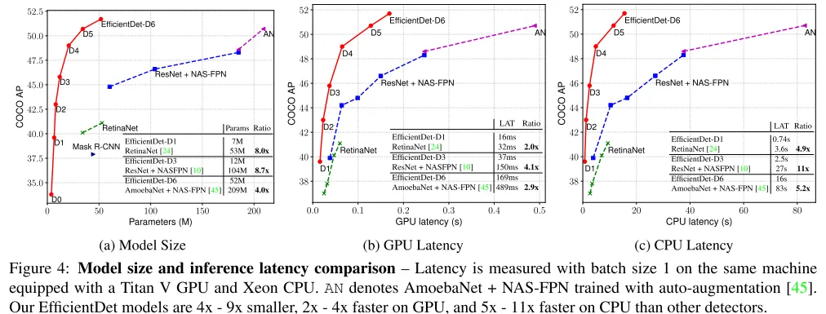
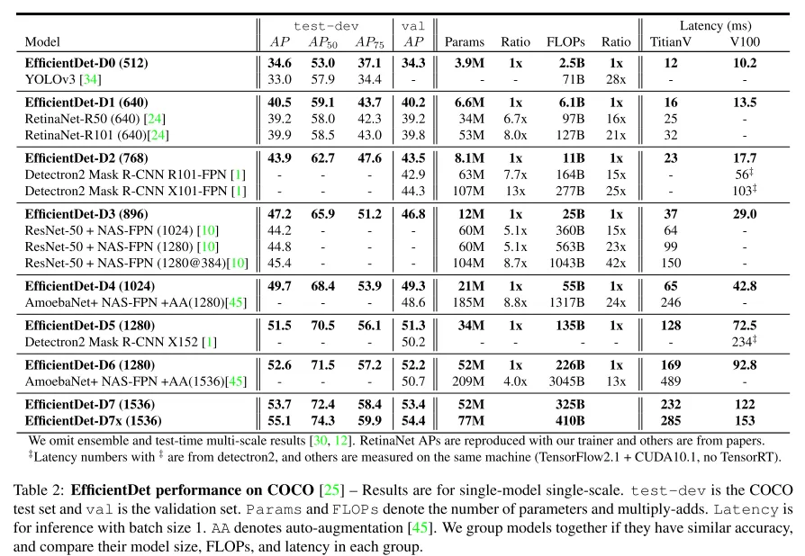
Result

Slide 11
Result
Research Content
To achieve efficient object detection, we propose ‘network architecture design choices’ to improve accuracy and efficiency, including a ‘weighted bidirectional feature network’ and a ‘customized compound scaling method.’
Through these optimizations, we developed a new family of detectors called EfficientDet.
Results
Achieved consistently better accuracy and efficiency compared to previous technologies under various resource constraints.
In particular, the scaled EfficientDet achieves state-of-the-art results with significantly fewer parameters and FLOPs than previous models.

Slide 12
Thank you for your attention.!!!
QnA

